Slide 1

Basics of Github

Slide 2
Pre -requisites
You have installed git on Windows, Linux or Mac following these instructions or similar: https://github.com/git-guides/install-git
You have access to a command prompt on Windows, Linux or Mac

Slide 3
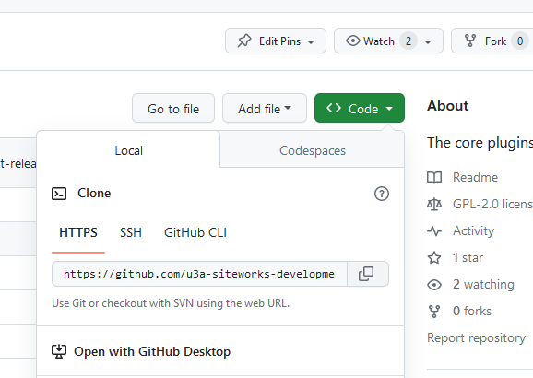

Cloning
The organization: https://github.com/u3a-siteworks-development/
Repositories all under this organization. All public.
To clone, click the code button, check HTTPS is underlined, and click the copy icon.
Open command prompt and chose a directory. “git clone “ <paste>
1
2
3

Slide 4
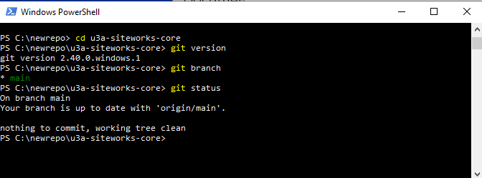
Useful commands

Slide 5
Where to clone into
I create a new directory and hold all the repos in it.
I copy a repo whole into Local Sites/<my site>/app/public/wp-content/plugins when I want to change it and test it.
I copy the whole repo back again when I have finished testing.
You might do that, or you might cd to that directory and git clone directly into it.
I like having one place where my repos all live – you might like having a separate clone in each site you are testing.

Slide 6
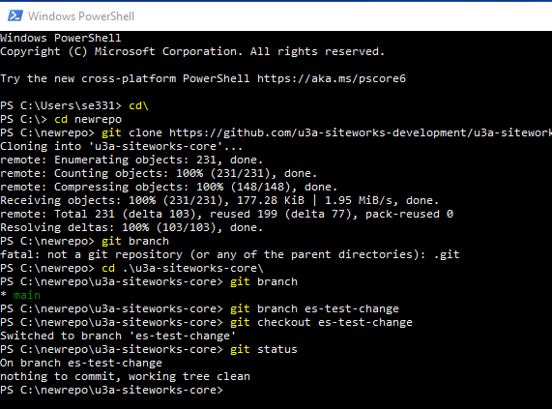
Checking in
Clone
Create new branch
Switch to new branch
Make your changes
Test

Slide 7
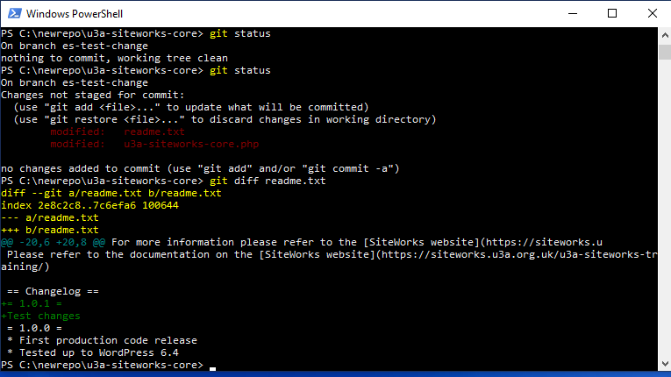
Examine your changes
Git status
Git diff <file>
Git diff *

Slide 8
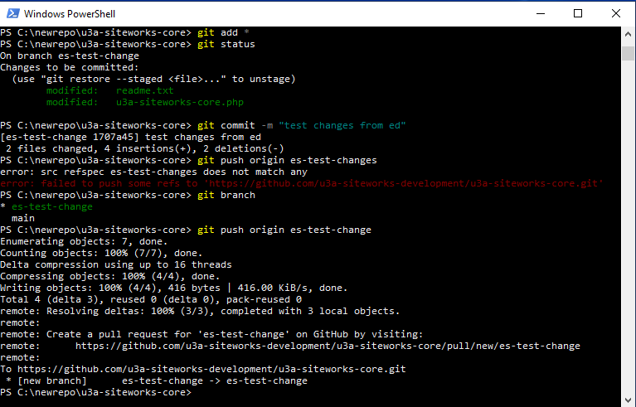
Check in
Git add <file>
Git add *
Git status – green?
Git commit –m “message”
Git push origin <branch>
Note – failure for bad branch name.
Go to github in browser to see the new branch.

Slide 9
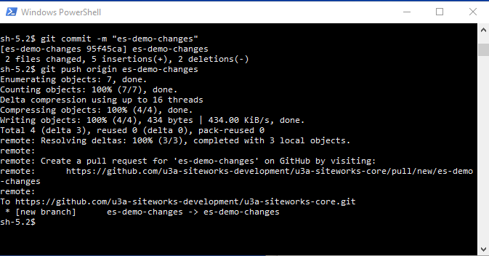
Pushing

Slide 10
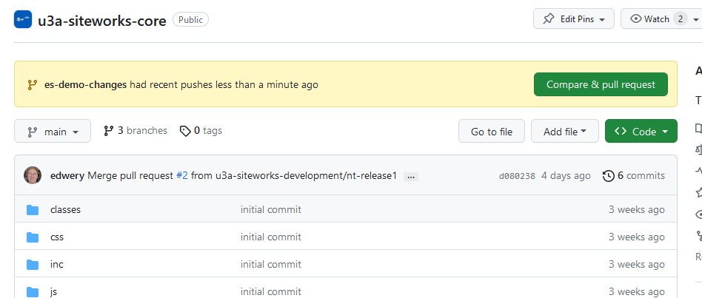
Create pull request
1

Slide 11
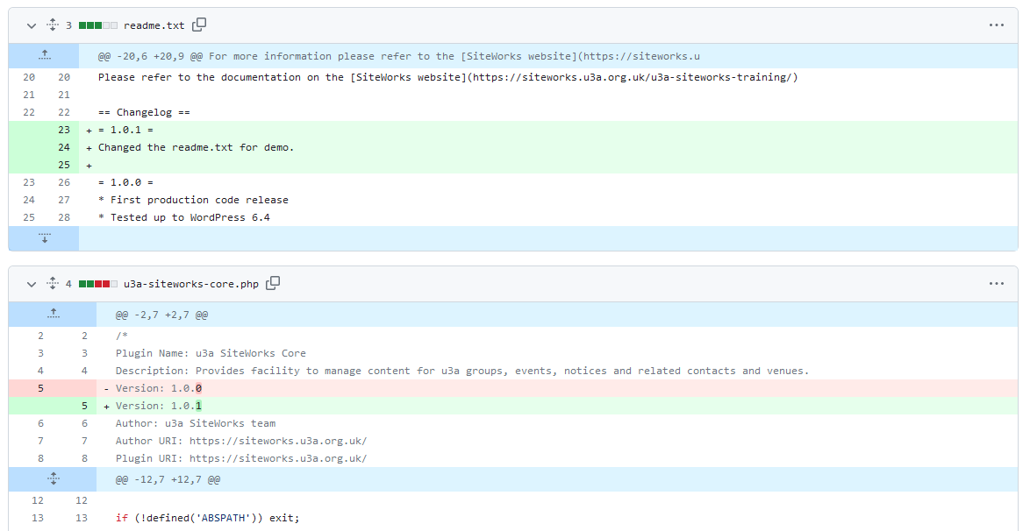
Check the changes on the review page (bottom)

Slide 12
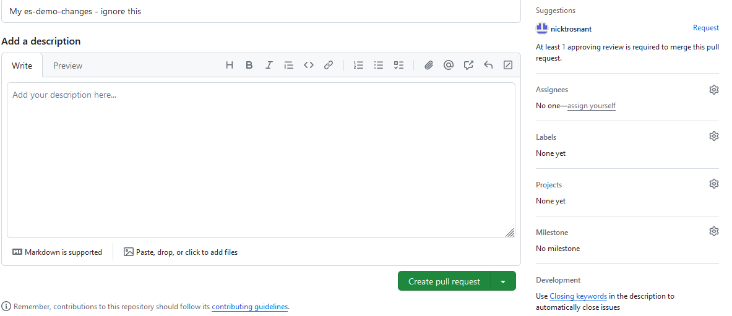
Comment and choose reviewer
1
3
2
4

Slide 13
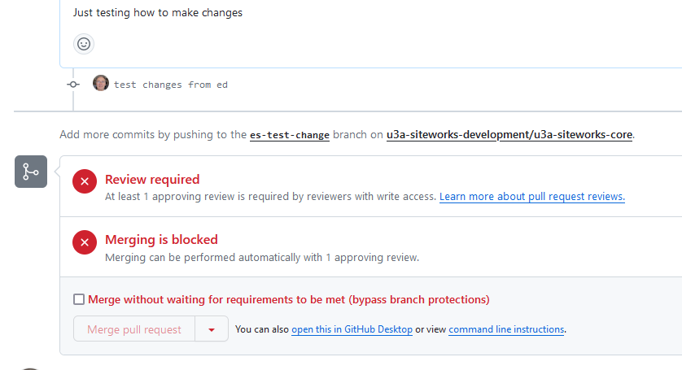
Merging
PR is blocked.
Reviewer will give a review, unblocking it.
Reviewer will merge.
Or you check the override and merge yourself.

Slide 14
Rules
No checking directly into main.
One review required on any pull request before merging.
All rules overridable by us all – just check the checkbox to agree to override.
Rules are in place just in case we get any external PRs.
Also make tracing bug origins slightly easier.

Slide 15
When the merge fails
Someone else has advanced main.
Best to get help the first time this happens.
Merge using the github page in the browser, select each change and choose what you want to do about the conflict.
OR..
Check out the branch
Git stash
check out main
Git pull origin main
go back to branch and git stash pop.
Fix the merge conflicts (look for ==== in code)
Push the changes again.

Slide 16
Other things you might use later
Git stash and git stash pop. Hides and re-shows a copy of the local branch.
Git rebase – squashes all the changes in a branch down to one, or rebases on a different base
These normally shouldn’t be needed.

Slide 17
Release Scheme
Update Server
Ext Bug
Release1
Release 2
PR
Main
Int Bug
Optional rebase
Feature 1
Feature 2

